Slide 1
Fundamentals of Software Architecture
Radócz Balázs
CONFIDENTIAL | © 2025 EPAM Systems, Inc.

Slide 2

Agenda
1
Introduction
2
Thinking Architecturally
3
A Design Process: A Brief Introduction
4
Broad Architectural Patterns

Slide 3
Reminder
Assessment – details will be available on e-learning. Expected on October 27 – based on first 6 weeks.
Only based on lecture material.

Slide 4
Introduction

Slide 5

Architect (noun)
Designer of complete systems
Describes a person
Architects design things (complete systems)
  Without every details (fill the implementation)
  The focus is on the structure

Slide 6
Architect Expectations
Make architecture decisions.
Continually analyze the architecture.
Keep current with latest trends.
Ensure compliance with decisions.
Diverse exposure and experience.
Have business domain knowledge.
Possess interpersonal skills.
Understand and navigate politics.

Slide 7


Architect
User problem
Architectures describe entire structures, systems in software with a purpuse
Effective architectures reflect the needs of the customer and the domain or business
  Computer systems solve real word problems
  The best arcthitectures reflect the structure of that real world
Never start with the implementation step like
  Programing language
  Database server
Start with the user problem and then figure out the best way to solve it
The implementation technology comes last
Arcthitect
Customer
Implementation
7

Slide 8
Architect
Traditional (waterfall organization)
Modern (agile)
Conceives the perfect design
Spends months or years producing big up-front design
Drawbacks
  Big and complex designs
    Code is written after design
    Doesn’t capture the users’s true needs
    Doesn’t allow for learning
  Lack of flexibility
    Painful bureaucratic processes
    Not following the design
    Random improvisation
  Slow development process
    Centralized architect-making decisions
Doesn’t want to settle on a particular design too soon
  You’ll learn about the problems as you solve them
Instead of it
  Build very small things
  Release them constantly
  Evolve based on feedback
Prefers incremental design
Notion of experimentation
  If you are not sure, run an experiment
  If experiment succeeds, adopt
  If it doesn’t throw the code and the architectute
Looks at rebuilding as less costly than building the wrong thing
Part of the team: teaching, coaching, coordinating
Notes:
Traditional architect drawback IBM case study:
Project: U.S. Air Traffic control system
After one year desinging the system became out-dated
The hardware and the air traffic control practices had moved on
They started over and came up another design
It became out-dates again
They were doing in 10 years and nothing was built

Slide 9
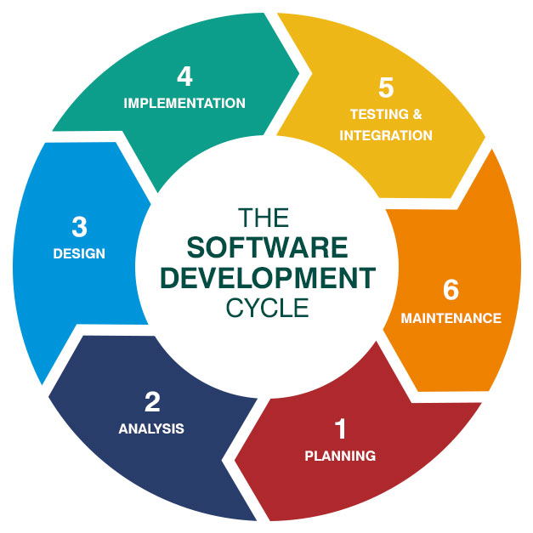
The software development cycle

Slide 10
“In most successful software projects, the expert developers
working on that project have a shared understanding of the
system design. This shared understanding is called
‘architecture.’ This understanding includes how the system is
divided into components and how the components interact
through interfaces. These components are usually
composed of smaller components, but the architecture only
includes the components and interfaces that are understood
by all the developers.” - Martin Fowler

Slide 11
„Architecture is about the important stuff.
Whatever that is.” - Martin Fowler

Slide 12
Thinking Architecturally

Slide 13
„Any organization that design a system will inevitably produce a design whose structure is a copy of the organization’s communication structure.” – Mel Conway

Slide 14
„Everything in software architecture is a trade-off” – First Law of Software Architecture

Slide 15
„Why is more important than how.” – Second Law of Software Architecture

Slide 16
Programmers know the benefits of everything and the trade-offs of nothing. Architects need to understand both.” – Rich Hickey - creator of Clojure programming language

Slide 17



Siloed Organization
DBAs
UI/UX team
Business Specialist
Database Layer
UI Layer
Business Logic

Slide 18

Conway’s Law
Change the structure of the organization to match agile methods.
Instead of horizontal silos
Cross-functional teams
  Have all the skills
  Own complete vertical slice of the system
Move to agile-friendly architectures
  Lets the team work faster

Slide 19
Incremental vs. big up-front design
Big Up-Front Design (BUFD)
Agile Incremental Design
User interface
Customer
Business logic
Stories
Database
Technology

Slide 20




Domain-Driven Design
The structure of your code should map to the structure of the problem domain
DDD-based systems are rarely N-Tiered systems because tiers are technical things (they don’t model any part of the domain)
Unique architectures to solve unique problems
The modules reflect the business, not the implementation technology
Subsystems might use completely different implementation technologies
Bounded context models natural divisions within the buiness whose problems we’re solving, the domain
  The communication is focused on the work that happens in the given context
  In the BUFD we try to come up with the universal model
Storefront
Invoice
Payment
Warehouse
Notes:
N-Tier system: Same as BUFD system

Slide 21
A Design Process: A Brief Introduction

Slide 22
Requirements gathering
Problem statement
User Story
Describes the end user’s problem
Describes the solution to the problem
Describes their work (not yours)
Describes an end user going through a domain-level process to achieve some valueable outcome
Does not describe a computer program
If you not providing actual value, solving some real problem, that one of your real users has in the real world, why would anybody want to use the software?
Stories need to be refined

Slide 23
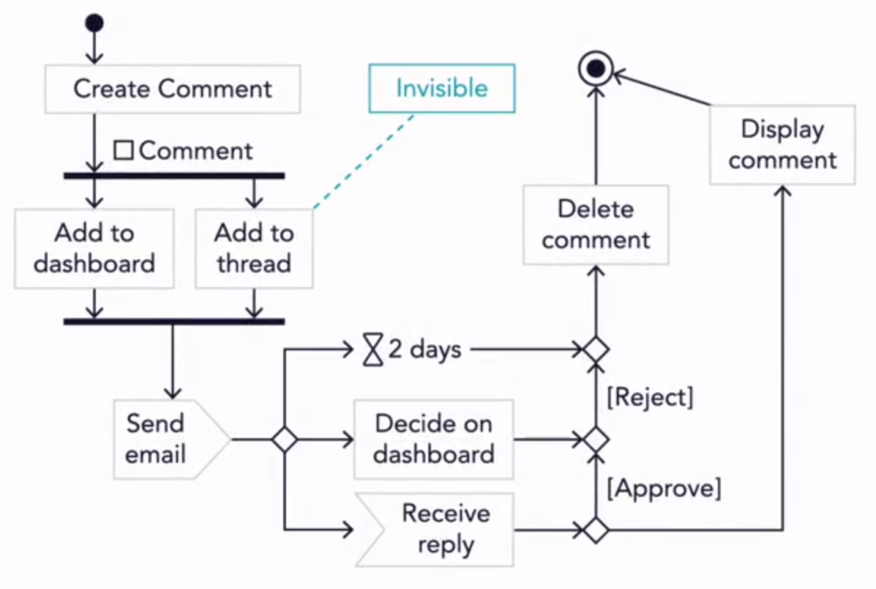
Narrowing
horizontal
Vertical
Story
User interface
Business logic
Database

Slide 24
Broad Architectural Patterns

Slide 25
Monoliths
The entire program is one large executable unit
Specified with hundreds and tousands of lines of source code
Mostly N-Tiered applications
Vetical and horizontal divisions
Strengths
  Homogeneous structure
Challenges
  Homogeneous structure
  Nobody understands the whole program
  Long test-and-deploy process
  Agility is nearly impossible

Slide 26
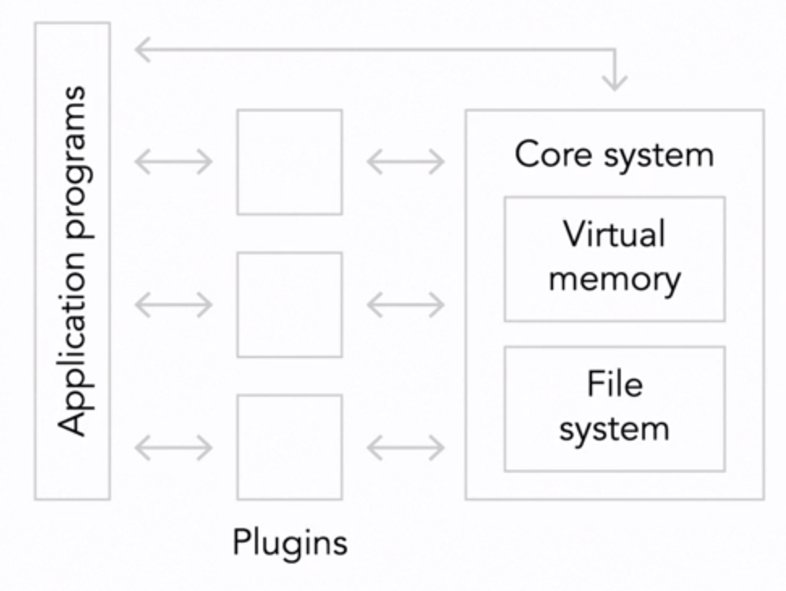
Microkernel (plugin) architectures
A Step up from a pure monolith
The first microkernel realization was an operating system
The idea is to put essential capabilities of your system into
a single stand-alone executable called the kernel
Strengths
  Isolation prevents big ball-of-mud dependencies
  Plugin are small and easy to write, debug and maintain
Challenges
  APIs to the kernel are delicate
  New APIs may require re-writing plugins
  Problems within a kernel can bring the system down
  Plugins are indirectly coupled through the kernel

Slide 27
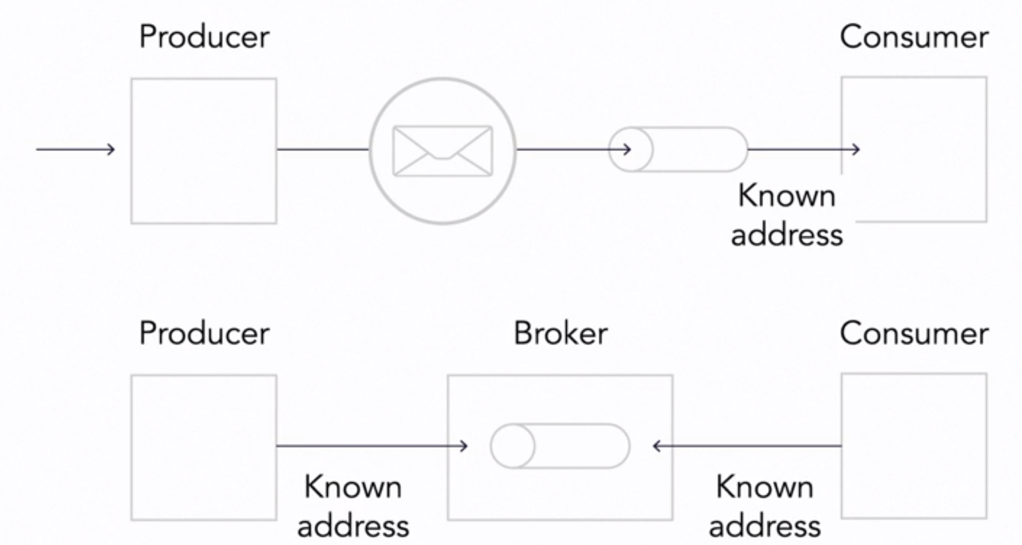
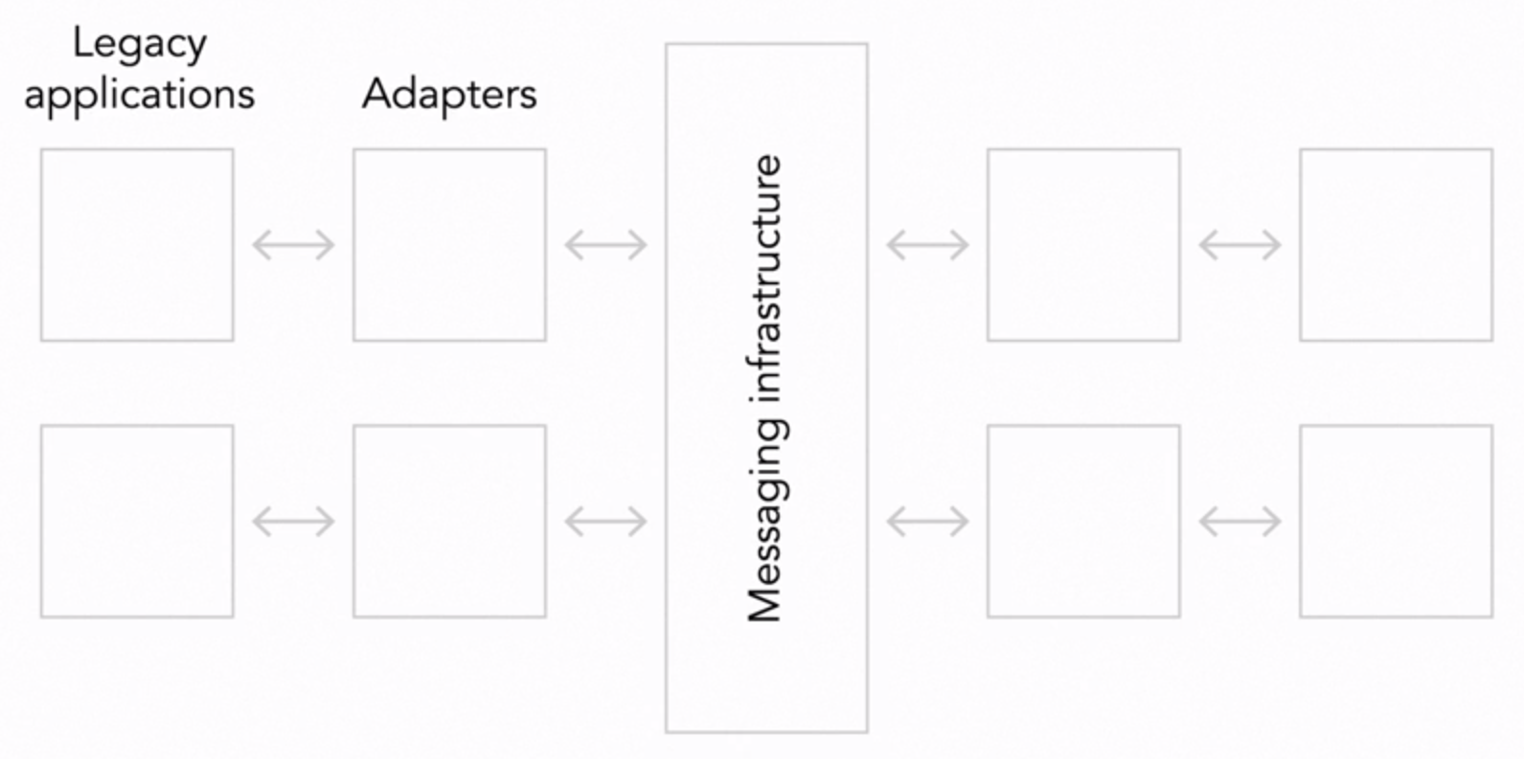
Message-based architectures
Formalizing the communication paths between elements and isolating them
Ease problems associated with network communication
Forge into a single system things that aren’t designed to work together
A common message bus control the flow of communication
Publish / Subscriber model
Strengths
  More maintainable than monolith
  Solve dependency problems in microkernel systems
Challenges
  Managing a highly complex system
  Can be very slow and time consuming
  Messages have to be stored on disk, replicated, backed up and so on

Slide 28
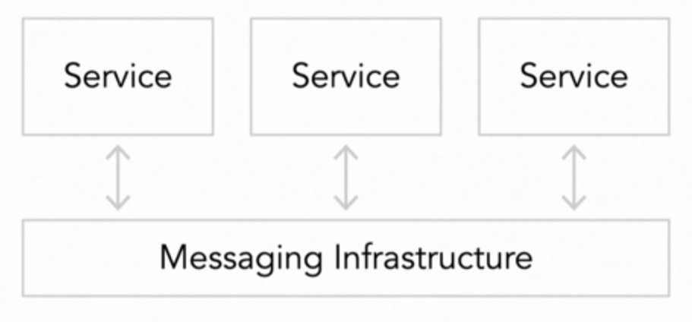
Microservice and miniservices
The large system is made up of a cloud of very small independent services that
cooperate as peers to get the larger work done
Supports distributed deployment and complex real-time interactions
Main requirements
  Small (few hundred lines of source code)
  Independently deployable
  Fully autonomous
  Hides implementation details
  Distributed
  Highly observable
  Modeled around business concepts
Strengths
  Independent services
  Changes do no affect the rest of the system
  Changes can occur quickly
Challenges
  Design and runtime complexity
  Network are slow compared to alternatives

Slide 29
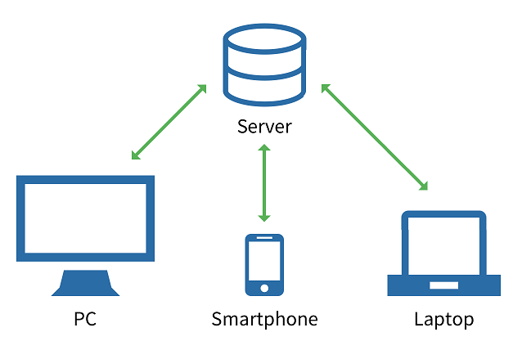
Client-Server Architecture

Slide 30
REST
Representational State Transfer
Defined by Roy Fielding in his 2000 PhD dissertation
Very popular architectural style for designing web services
Most commonly used over HTTP with JSON payload
Lightweight alternative to SOAP web services
Things vs. actions
Nouns vs. verbs
Web Service API
  Adhering to REST constrains
Defines a set of architectural constraints
  Client - Server architecture
  Stateless
  Cache
  Uniform interface
  Layered system
  Code on demand (optional)
HTTP based
  Accessible on a base URI (http://localhost:8080/message/1)
  Provides an Internet Media Type (JSON, XML, image etc.)
  Implements standard HTTP methods (CRUD: POST, GET, PUT, DELETE)
Notes:
SOAP jellemzői:
Protokoll: Szabványosított, XML-alapú üzenetküldési protokoll.
Tömegesség: Verbózus, mert az XML terjedelmesebb a JSON-nál, ami nagyobb sávszélességet igényel.
Biztonság: Robusztus beépített biztonsági funkciókkal rendelkezik, amelyek ideálisak magas biztonsági követelményű környezetekhez.
Állapotkezelés: Lehet állapottartó (stateful) vagy független (stateless).
Támogatottság: Számos kiterjesztéssel rendelkezik, például WS-Addressing a megbízható üzenetküldéshez.
REST jellemzői:
Architektúra: Egy architektúra stílus, nem pedig egy konkrét protokoll, amely szabványokat határoz meg a webes szolgáltatásokhoz.
Tömegesség: Könnyű adatformátumokat, mint a JSON használ, ami általában gyorsabb és kevesebb sávszélességet igényel.
Adatátvitel: HTTP protokollra támaszkodik, és erőforrás-alapú.
Állapotkezelés: Természetéből fakadóan független (stateless), ami egyszerűsíti a szerver-kliens kommunikációt.
Skálázhatóság: Nagymértékben skálázható, és könnyen támogatja a cache-elést.
Mikor melyiket válasszuk?
SOAP:
Ha komplex tranzakciókra, szigorú biztonsági követelményekre van szükség, vagy ha integrálni kell meglévő vállalati rendszerekkel.
REST:
Ha könnyű, gyors és nagy mértékben skálázható szolgáltatásokra van szükség, különösen mobilalkalmazásokhoz vagy nyilvános API-khoz.

Slide 31
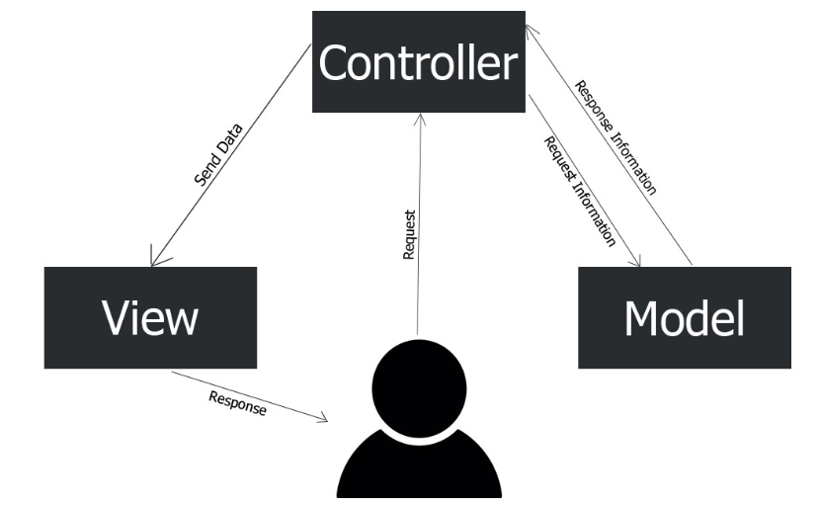
MVC
Model-View-Controller
Notes:
Modell (Model):
Ez a rész tartalmazza az alkalmazás adatkezelési logikáját és az üzleti logikát. Kezeli az adatok lekérését és tárolását, így az adatok és az alkalmazás logikája elválik a megjelenítéstől.
Nézet (View):
Felelős az adatok felhasználó elé tárásáért és a felhasználói interakciók fogadásáért. Például egy táblázat, kördiagram vagy más grafikus forma egy-egy nézet.
Vezérlő (Controller):
Ez az összetevő a híd a Modell és a Nézet között. Fogadja a felhasználó műveleteit (pl. gombnyomás, kattintás) és az alapján módosítja a Modell adatait, majd a Nézetet is frissíti.

Slide 32
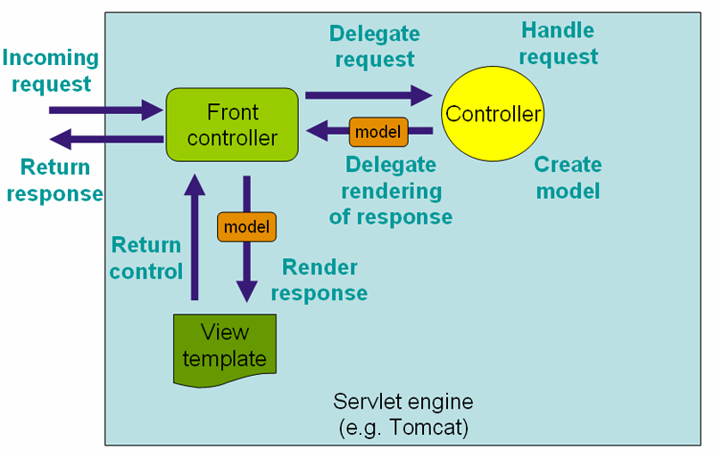
Front Controller
Spring MVC Model

Slide 33
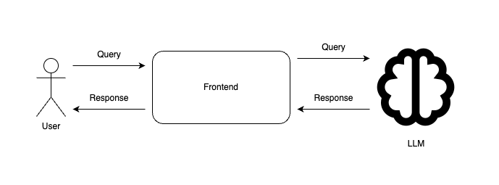
Generative AI & LLMs

Slide 34
Retrieval Augmented Generation - RAG
Combines retrieval mechanisms with generative models to enhance response accuracy and relevance.
Leverages external datasets to provide contextually rich and up-to-date information.
Improves model performance by grounding responses in factual data, reducing hallucinations.
Classic LLM Prompting: Relies solely on pre-trained knowledge, potentially leading to outdated or less grounded responses.
RAG: Integrates real-time data retrieval, enhancing both the accuracy and reliability of generated content.

Slide 35
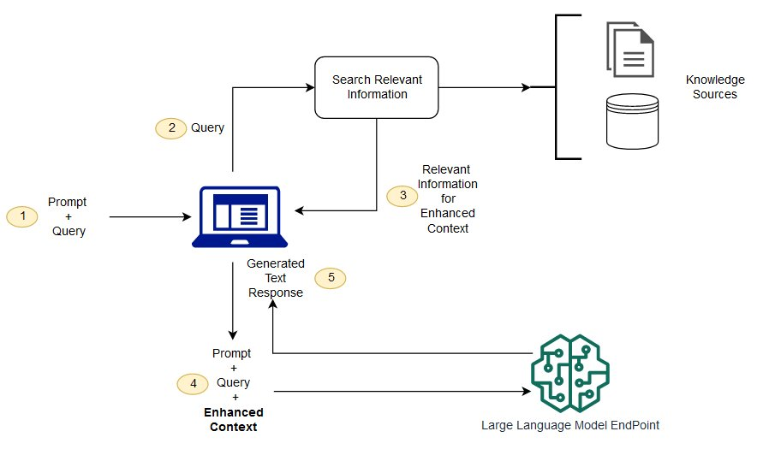
Retrieval Augmented Generation - RAG

Slide 36
Case Study: Prime video
Moving from microservices & Serverless to monolith
Amazon Prime Video developed a tool to monitor every stream viewed by a customer to allow automatical identification of quality issues and trigger a process to fix it.
After scaling it, they noticed that it was very very expensive.
Initial design created as a distributed system. The idea was to scale each component independently.
They hit a hard scaling limit at around 5% of the expected load.
The main scaling bottleneck in the architecture was the orchestration management that was implemented using AWS Step Functions.
Conclusion and results:
  Microservices and serverless components are tools that do work at high scale, but whether to use them over monolith has to be made on a case-by-case basis.
  Moving this service to monolith reduced the infrastructure cost by over 90% and increased scaling capabilities.
Source: link.

Slide 37
Thank you for your attention
Official Contacts:
Email: BALAZS_RADOCZ@epam.com

